Slide 1

UNIT 1;
With you from the start
Next of kin

Slide 2

What is your family like?
How do you spend time in your family?
JUST CHATTING
„If you want to call a family meeting, just turn off the Wi-Fi router and wait in the room in with it is located.” (unknown)
Is your family like this?
What do you do with each member of your family?
What do you do together?

Slide 3
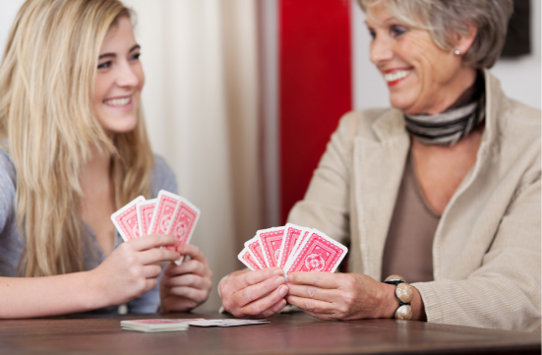

Nancy is talking to her friend Olivia about her holidays.
Who is who in her family?
Listen and match. (TASK 1, page 8)
https://www.e-sfera.hr/dodatni-digitalni-sadrzaji/627ec4eb-92c2-48c3-a83d-b97efedec711/assets/audio/1_1.mp3
Task 1
https://wordwall.net/resource/4246357/engleski-jezik/07unit-1-next-kin-01

Slide 4
Listen again and decide whether these sentences are TRUE or FALSE. (TASK 2, page 8)
https://www.e-sfera.hr/dodatni-digitalni-sadrzaji/627ec4eb-92c2-48c3-a83d-b97efedec711/assets/audio/1_1.mp3
Nancy’s aunt Phoebe is short and blonde.
Her uncle George is a nature park volunteer.
Nancy’s cousin Paul can dive.
They had beautiful weather during the weekend.
Her grandparents can’t play cards.
Task 2
https://wordwall.net/resource/4246679/engleski-jezik/07unit-1-next-kin-02
Nancy’s aunt Phoebe is tall and blonde.
They didn’t have beautiful weather during the weekend.
It was raining.
Her grandparents can play cards.

Slide 5
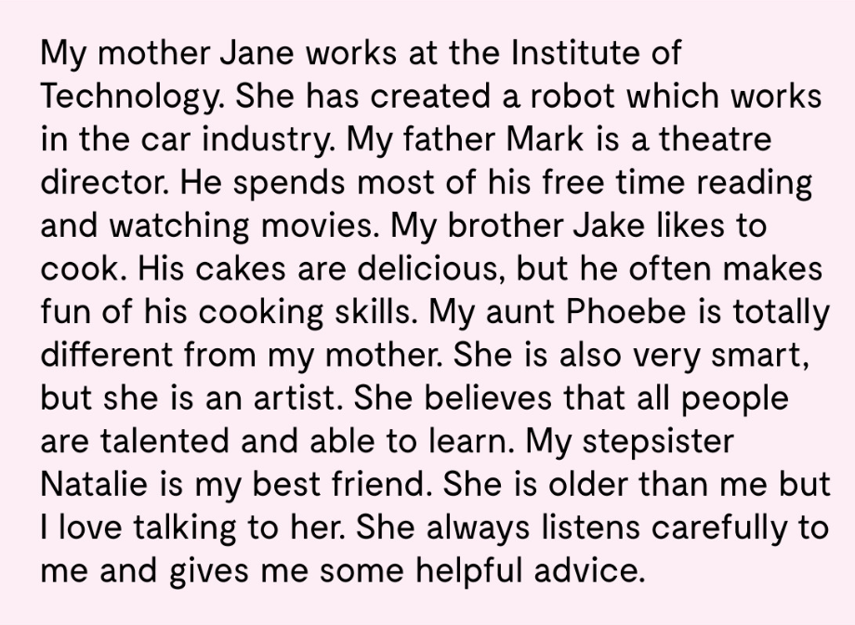
Read what Nancy says about her family members.
Who would she talk to if she…
… needed a new mobile phone?
… felt like eating pancakes?
… got an F in a difficult subject?
… had a fight with her friend?
… needed a recomendation
for a book or a movie?
… her mum Jane, because she’s good with technology.
… her brother Jake, because he likes to cook.
… her aunt Phoebe, because she’s very smart.
.. her stepsister Natalie, because she is her best friend.
… her dad Mark, because he likes to read and watch movies.

Slide 6
Match the definitions with words and phrases from the text. (TASK 5, page 9)
Task 5
https://wordwall.net/resource/4246953/engleski-jezik/07unit-1-next-kin-03
in-laws – obitelj supružnika
great-grandmother - prabaka
offspring - potomstvo
siblings – braća i sestre
ancestor - predak
next of kin – najbliža rodbina

Slide 7
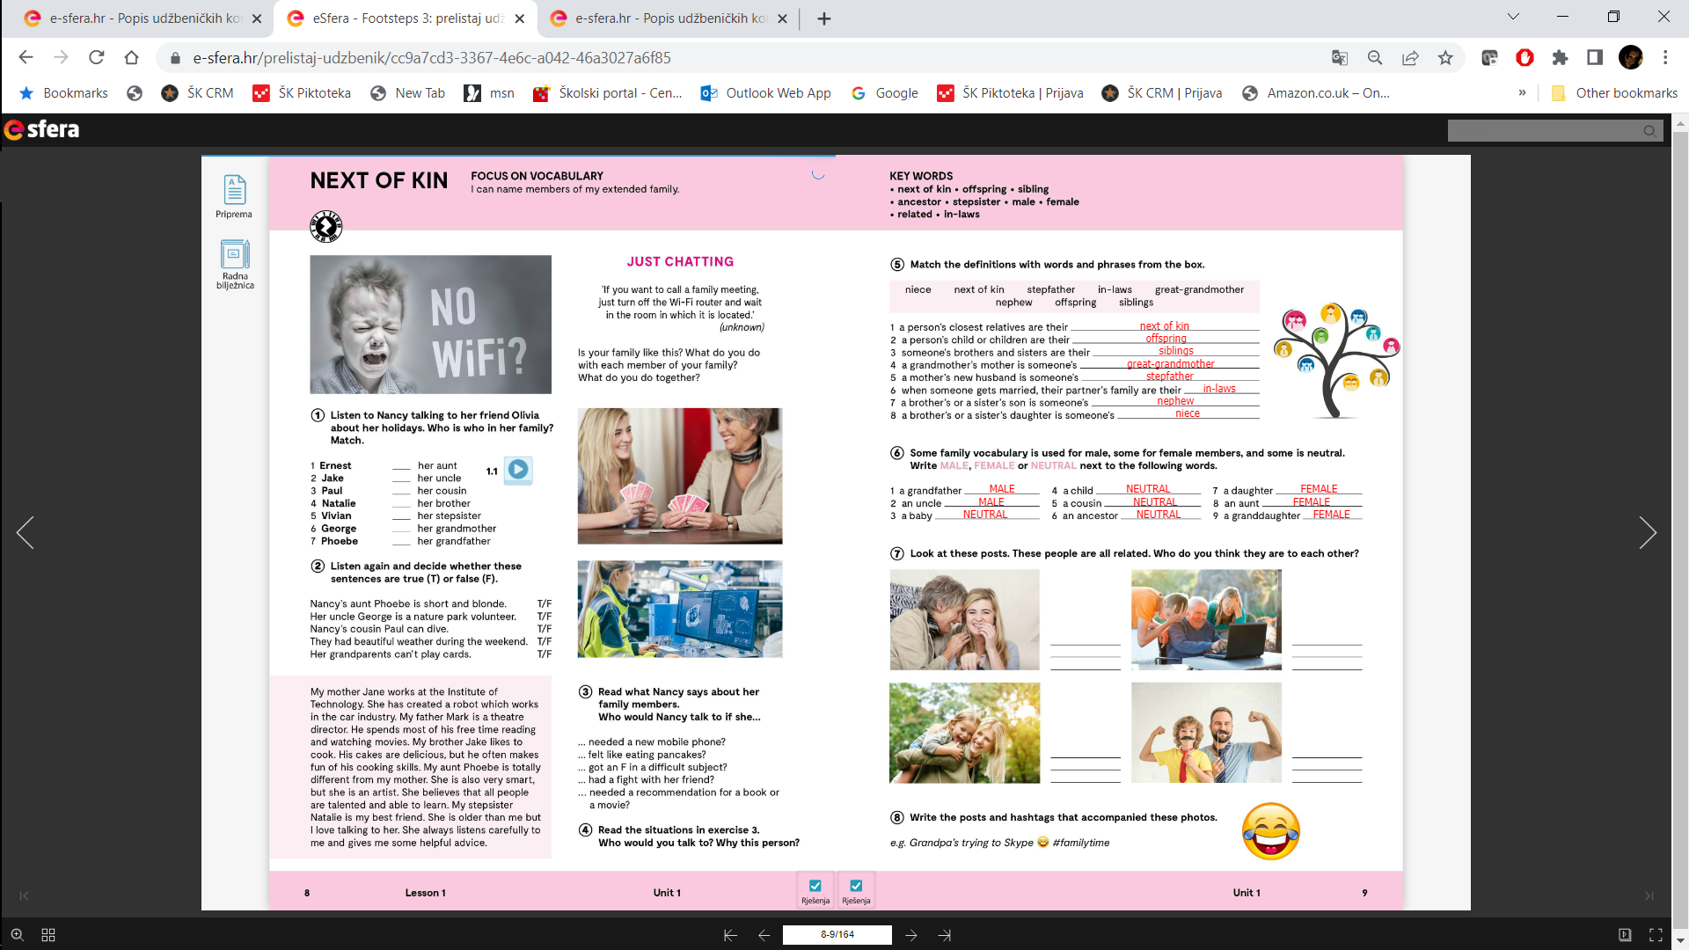

Slide 8
Some family vocabulary is used for male, some for female members, and some is neutral.
Write MALE, FEMALE or NEUTRAL next to the words in TASK 6, page 9.
A GRANDFATHER – djed (muški rod) MALE,
A DAUGHTER – kći (ženski rod) FEMALE
A CHILD – dijete / dječak ili djevojčica? NEUTRAL
Let’s practise
https://learningapps.org/watch?v=ptd88khv520

Slide 10
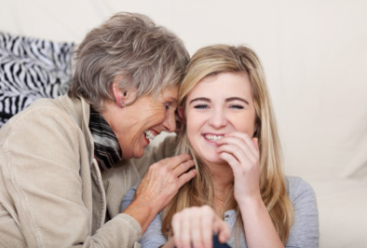
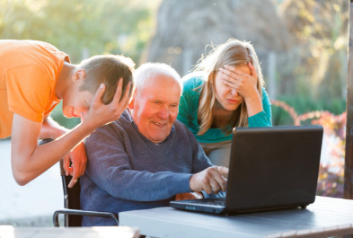

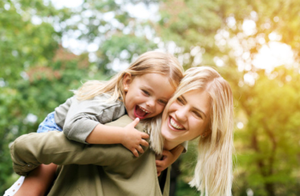
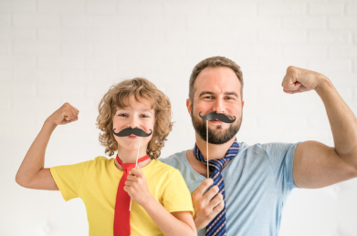
These people are all related. Who do you think they are to each other?
Grandpa’s trying to Skype
#familytime
Write the posts and hastags that accompanied these photos.

Slide 11
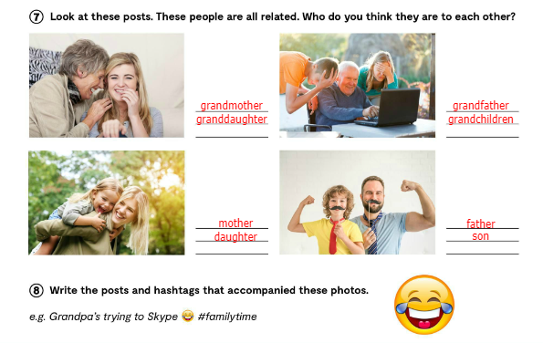

Slide 12
